Slide 1
Gulp 4.0
Introduction for the .NET Developer
Justin James
@digitaldrummerj | http://digitaldrummerj.me
#MusicCityCode

Slide 2


Slide 3
Why Use Gulp?
Automate Repetitive Tasks
Improve Efficiency
Frees up Your Time

Slide 4

What Can You Do?
Compile .NET Projects
Increment Version Numbers
Lint Javascript
Concat and Minify
Sass Compilation
Inject Files References into HTML Code
Refresh Browser on File Changes

Slide 5
What is in it for me?
Repeatable
Deliver Faster
Improve Quality

Slide 6
Gulp Basics
Gulpfile.js
Code over configuration
Stream based
1100+ plugins

Slide 7
Gulp Streams in a Nutshell
File System
Dest
Read Files
jshint
uglify
concat
Write Files

Slide 8
Gulp Streams In Action
Start with a source set of files
Process or examine the files
Send output to a destination

Slide 9
Processing against the files is done in memory making Gulp very fast.

Slide 10
State of Gulp 4.0
Currently in beta
Been using in production for almost a year with no issues
Docs are on 4.0 branch on Github
CLI is compatible with 3.x release

Slide 11
Gulp APIs

Slide 12
6 APIs
task
src
dest
watch
series
parallel

Slide 13
gulp.task (name, fn)
gulp.task("default", function (done) {
console.log("Hello Music City Code");
done();
});
Callable container for actions against files
New for Gulp 4 - optional callback to indicate task is done.

Slide 14
2. gulp.src ( glob [, options] )
gulp.task("lint", function () {
return gulp.src(['./app/**/*.js',
'!./node_modules/**/*'])
.pipe(plugins.eslint())
});
Get a set of files to take action on
To exclude paths, add a ! In front of the path

Slide 15
3. gulp.dest ( folder [, options] )
gulp.task("bump:patch", function () {
return gulp.src('./**/AssemblyInfo.cs')
.pipe(plugins.assemblyInfo({ version: newVer }))
.pipe(gulp.dest('./'));
});
Write files to destination
Optionally specify options to apply to the output folder

Slide 16
gulp.watch ( glob [, options])
var styleWatcher = gulp.watch(styles,
{ ignorePermissionErrors: true });
styleWatcher.on('add', function (file) { });
Monitor paths/files for changes. Rewritten for Gulp 4
Events: add, addDir, change, unlink, unlinkDir, ready, raw, error, all
Notes:
.on(event, callback): Listen for an FS event.
Available events: add, addDir, change, unlink, unlinkDir, ready, raw, error.
Additionally all is available which gets emitted with the underlying event name and path for every event other than ready, raw, and error.
see: https://github.com/paulmillr/chokidar

Slide 17

gulp.series (name, name, fn)
gulp.task('inject'), gulp.series(
injectJavaScript,
injectCss
));
New for Gulp 4 - true way to do dependencies
Note: returns function, so can’t be used within a function

Slide 18
gulp.parallel (name, name, fn)
gulp.task('inject'), gulp.parallel (
injectJavaScript,
injectCss
));
New for Gulp 4 - runs just like old dependencies did. all at once.
Note: returns function, so can’t be used within a function
Notes:
Need Code!!

Slide 19
Combine series and parallel
gulp.task('inject'), gulp.series (
RunFirst,
gulp.parallel (injectJavaScript, injectCss)
));
Notes:
Need Code!!

Slide 20
Installing Gulp 4.0

Slide 21
Getting Node.js
Manual Install
Automated Install
Run installer from
http://nodejs.org
Install Chocolatey
https://chocolatey.org/
choco install nodejs -y

Slide 22
npm install -g gulp-cli
npm init
npm install –save-dev git+https://git@github.com/gulpjs/gulp.git#4.0

Slide 23
package.json
"devDependencies": {
"gulp" : "git+https://git@github.com/gulpjs/gulp.git#4.0"
}
Holds all of the node module dependencies and development dependencies.

Slide 24
require is the way that you pull in node modules.
'use strict';
var gulp = require('gulp');

Slide 25
Running Tasks in Visual Studio

Slide 26
Tasks in Visual Studio
Runs gulp tasks from Visual Studio
Use existing tasks
Add actions via custom bindings

Slide 27
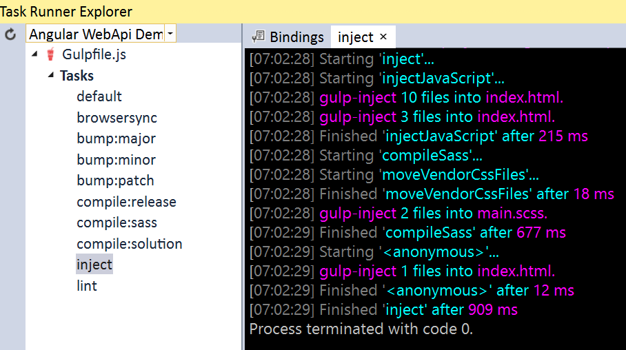
Task Runner Explorer

Slide 28
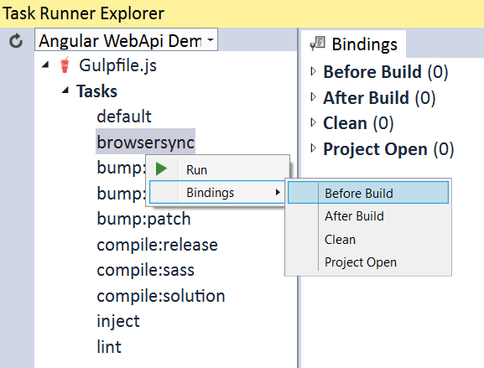
Add Custom Bindings

Slide 29
Coding Time

Slide 30
Summary

Slide 31
What We’ve Learned
Why you should use Gulp
How to use Gulp
How to create tasks

Slide 32
6 Gulp APIs
task
src
dest
watch
series
parallel

Slide 33
Resources
http://gulpjs.com/plugins/
http://gulpjs.com
Gulp Plugins
Gulp Main Web Site

Slide 34
Thank you
http://digitaldrummerj.me/speaking/#gulp
@digitaldrummerj

